Slide 1







Predicting Flight Delays
By: Luz, Schadrack,Loic

Slide 2
Table of contents
01
02
Data Overview
Data Exploration
03
04
Feature Engineering
Modeling

Slide 3


2 data sets: January 2019 and January 2020
Location: USA
600,000 rows in each data set
Columns: Date, Airport, Time, Airline, Distance, Delay and more

Slide 4




Can We Predict Flight Delay?
What factors influence delay?

Slide 5



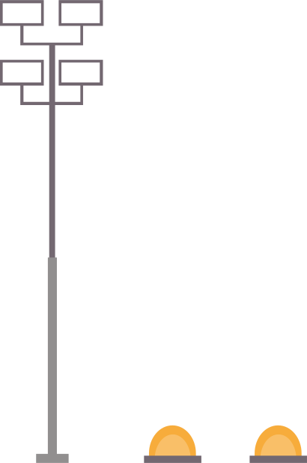
Data Exploration

Slide 6
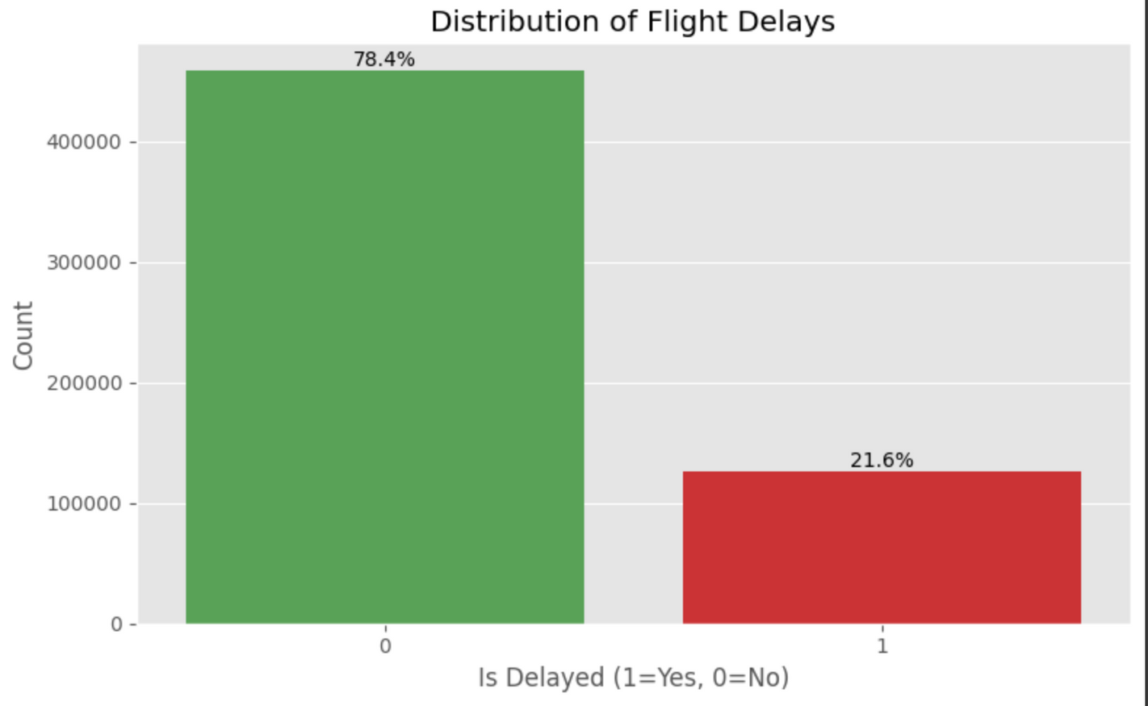
About The Data
78.4% Not Late
<15min delay
21.6% Late
15+ min delay

Slide 7
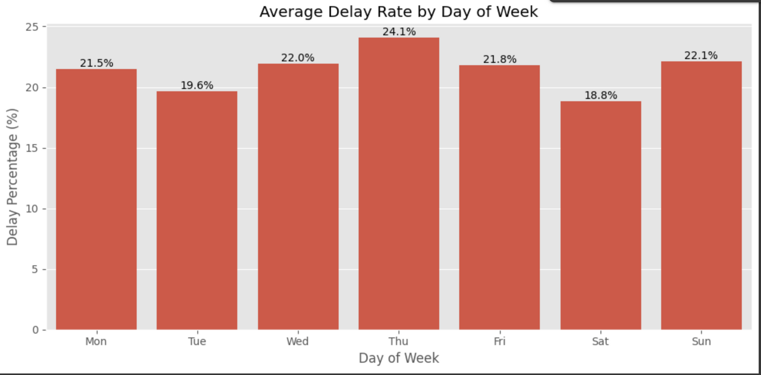
ALL Delay By Day Of The Week
Wednesday 22%
Thursday 24.1%
Sunday 22.1%

Slide 8
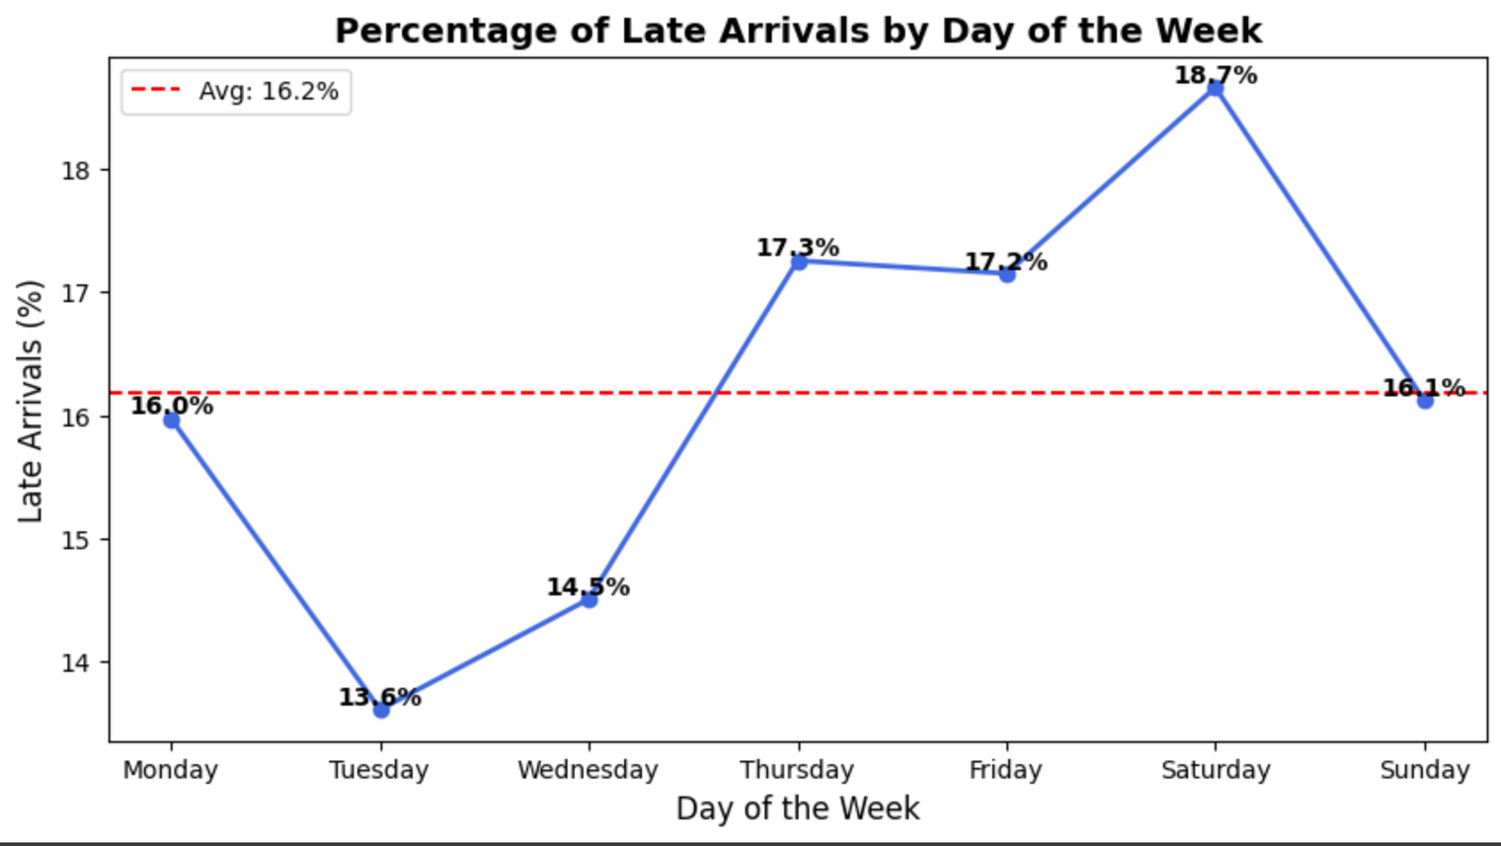
Late Arrival Only By Day Of The Week
Rises Wed-Thursday
Peaks Saturday

Slide 9
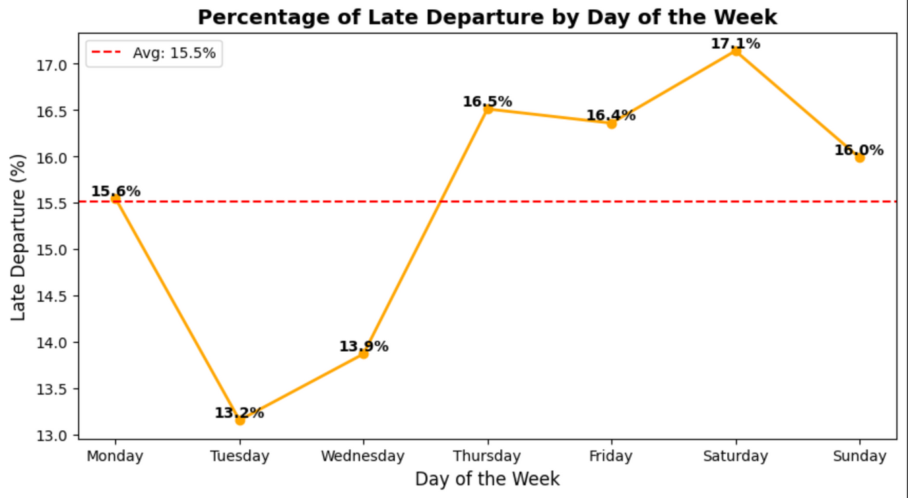
Late Departure Only By Day Of The Week
Similar Trends than Departure

Slide 10
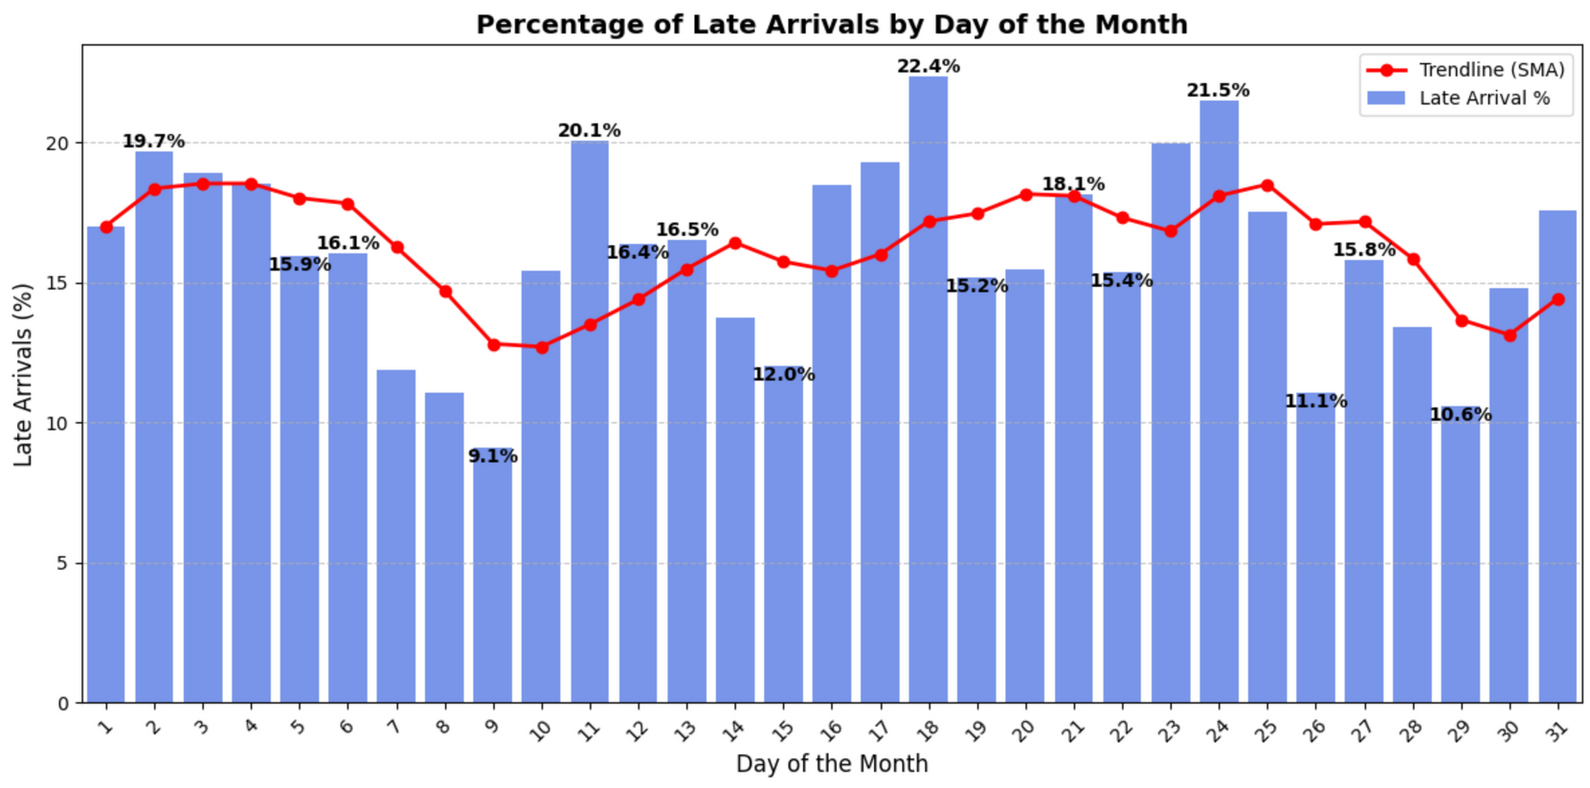
Late Arrival Only By Day Of The Week

Slide 11
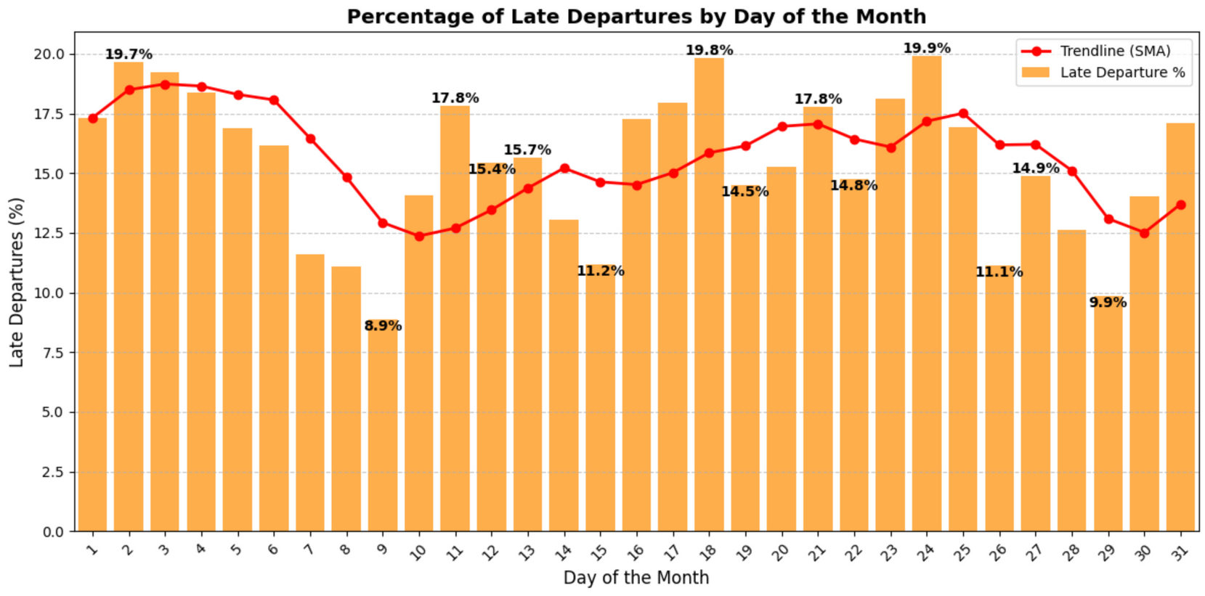
Late Departure Only By Day Of The Month

Slide 12
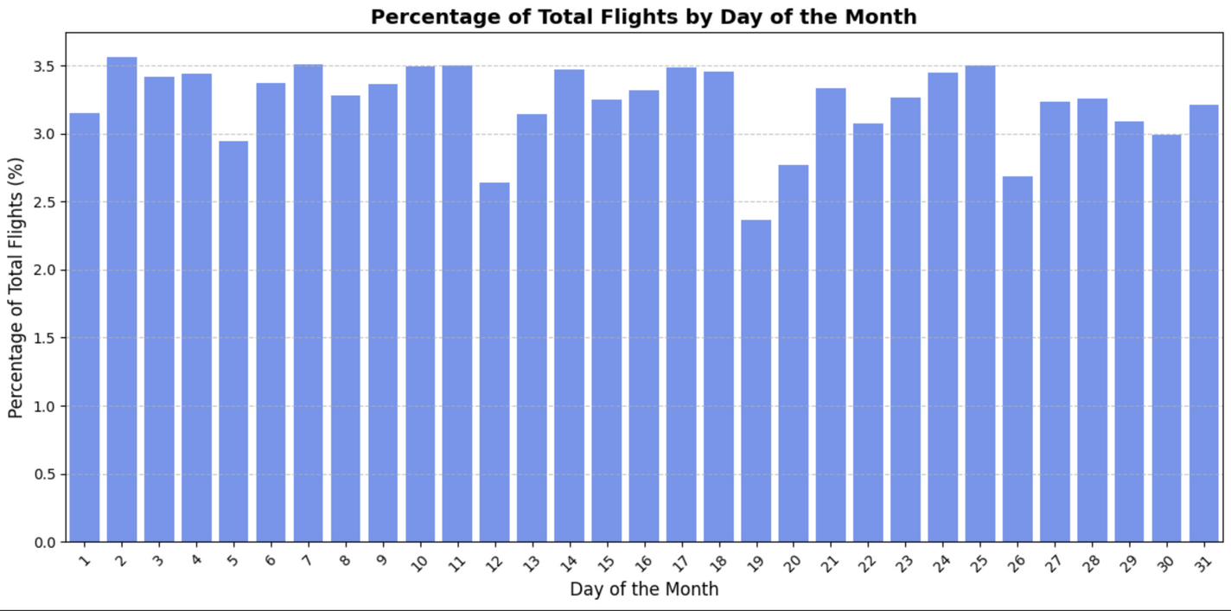
Percentage Of All Flights By Day Of Month

Slide 13
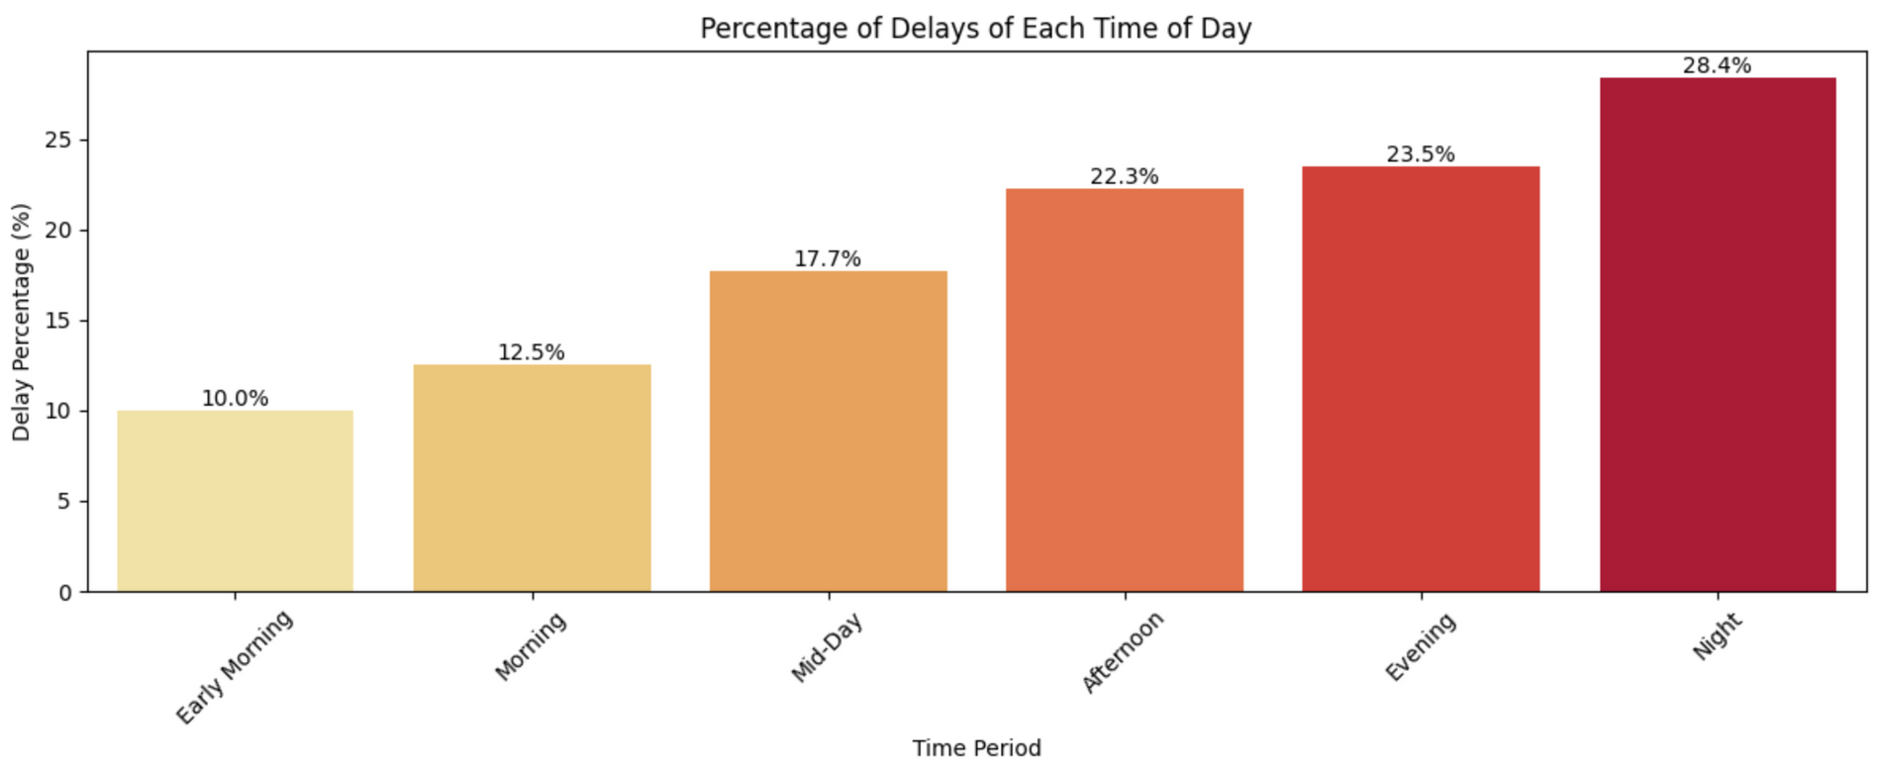
All Delay by Time Block

Slide 14
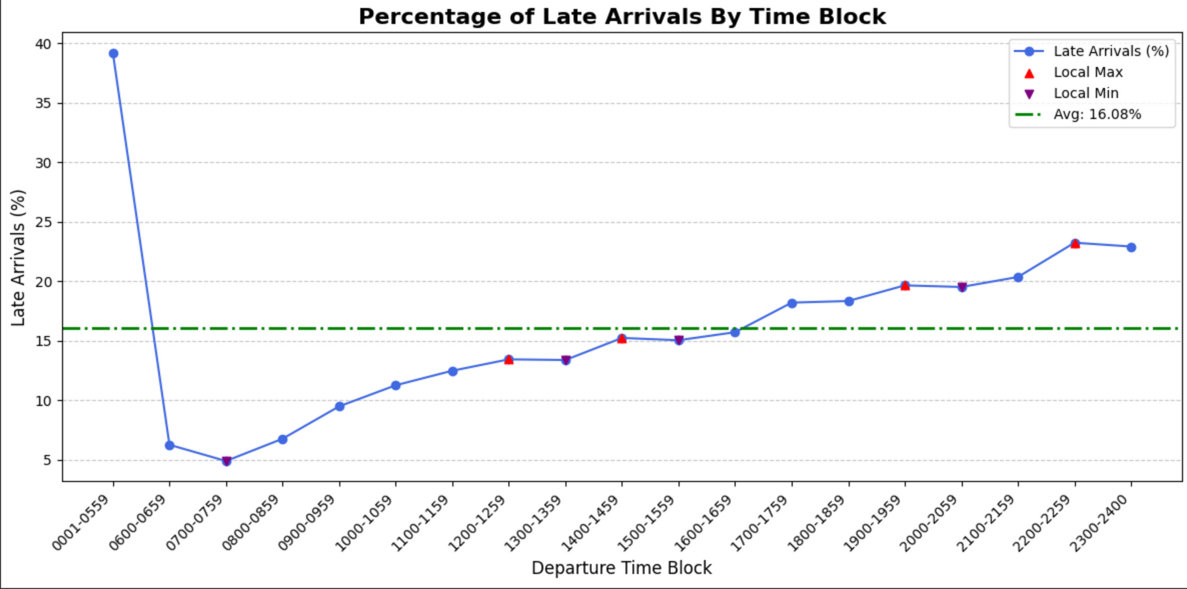
Arrival Delay Timeseries

Slide 15
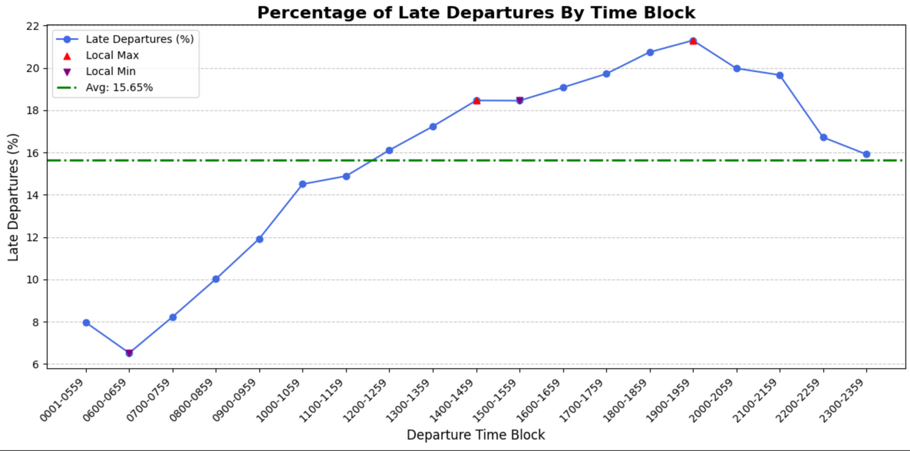
All Delay by Time Block

Slide 16
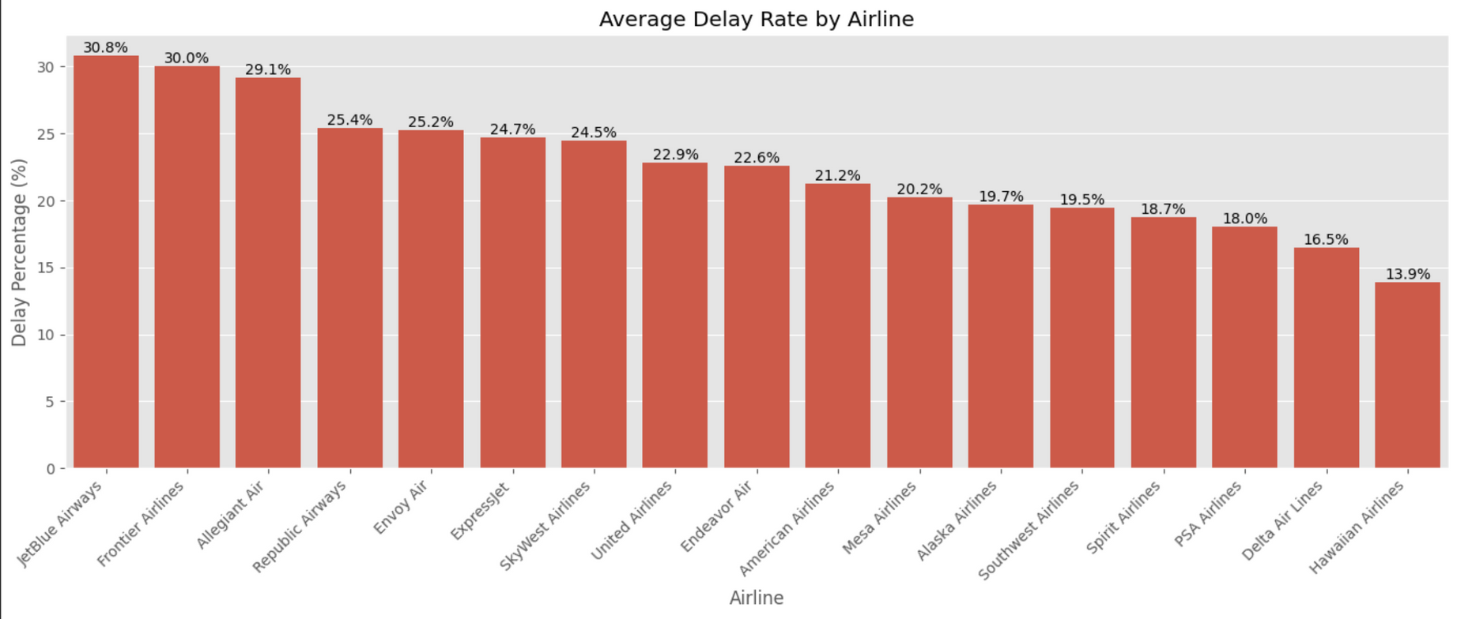
All Delay by Airline
Top 3
Jet Blue
Frontier
Allegiant
Bottom 3
PSA
Delta
Hawaiian

Slide 17



Problem
Jet Blue Fined by DOT $2M for habitual delays

Slide 18
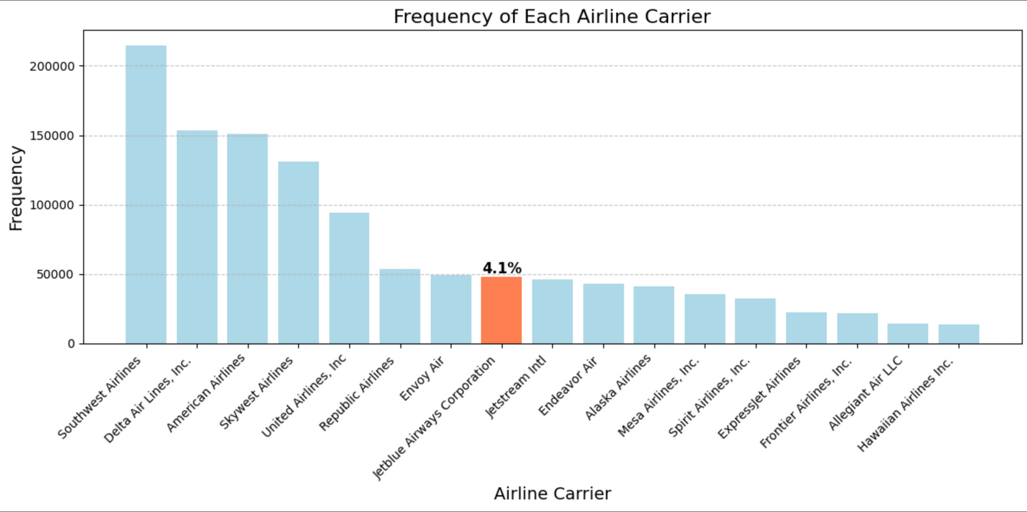
Airlines Flying Most Frequently

Slide 19
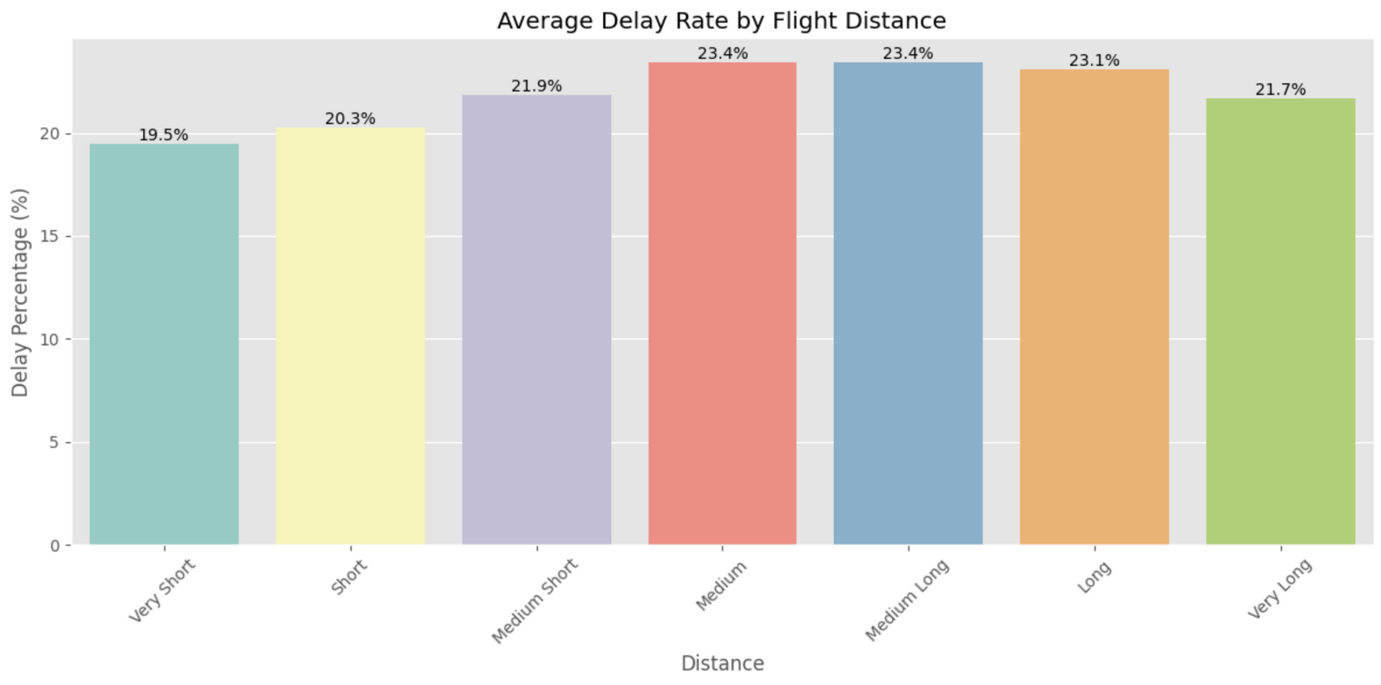
Flying Delays By Distance
Very Short
0-250m
Short
251-500m
Medium Short 501-1000m
Medium
1001-1500m
Medium Long 1501-2000m
Long
2001-3000m
Very Long
3001-5000m

Slide 20
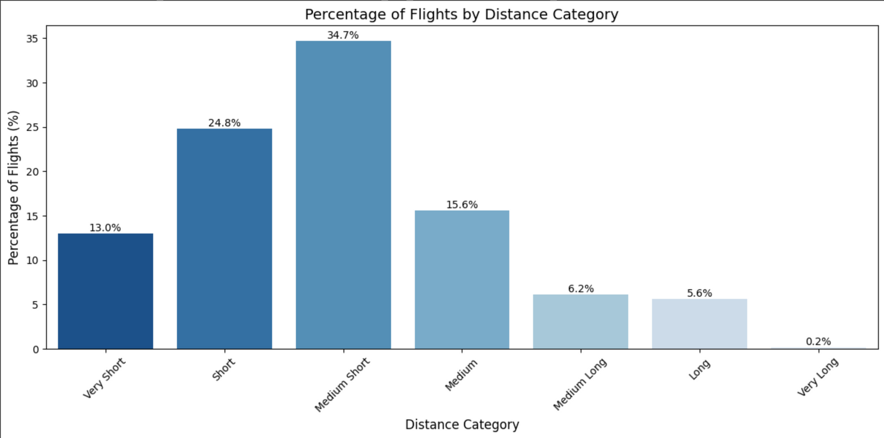
Frequency by Distance Category

Slide 21

Feature Engineering

Slide 22
Feature Engineering
Day Of The Week
Day Of The Month
Departure Time In Minutes
Sin and Cosine
Sin and Cosine
Sin and Cosine
Departure Time Block
Most Frequent Routes
One Hot Encoded
One Hot Encoded

Slide 23
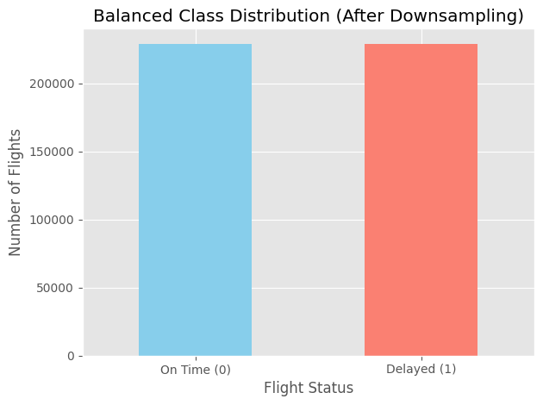
Addressing Class Imbalance
Original data was imbalanced
Applied downsampling to balance the classes
Improve fairness and accuracy in evaluation

Slide 24

Modeling

Slide 25
Model Results
Logistic Regression | 0.66 | 0.71 | 0.66 | 0.64 | 0.65
Random Forest | 0.76 | 0.83 | 0.78 | 0.72 | 0.75
XGB classifier | 0.77 | 0.87 | 0.81 | 0.72 | 0.76
Models
Accuracy
AUC
Precision
Recall
F1
Logistic Regression has lower performance
XGBoost has best overall results

Slide 26
After Hyperparameter Tuning
Logistic Regression | 0.69 | 0.72 | 0.68 | 0.68 | 0.67
Random Forest | 0.78 | 0.81 | 0.80 | 0.74 | 0.77
XGB classifier | 0.8 | 0.88 | 0.83 | 0.75 | 0.79
Models
Accuracy
AUC
Precision
Recall
F1
Tuning improved all models
XGBoost leads in all metrics
Best Paramaters
Logistic Regressions
C = 0.1, solver = 'liblinear'
Random Forest
n_estimators = 150, max_depth = 20, min_samples_split = 5
XGBoost
n_estimators = 150, max_depth = 7, learning_rate = 0.05, subsample = 1.0

Slide 27
Voting Classifier Results
Hard Voting | 0.773 | 0.68 | 0.68
Soft Voting | 0.81 | 0.79 | 0.74
Soft Voting had the best overall performance across all metrics
Balanced precision and recall for delayed flight detection
Voting Classifier
Accuracy
Precision
Recall

Slide 28
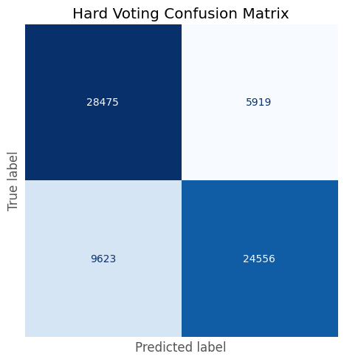

Voting Classifier Results
Soft Voting predicts slightly more delayed flights correctly
Lower false positives in Soft Voting (fewer misclassified on-time flights)
Both models perform similarly, but Soft Voting offers a better balance

Slide 29
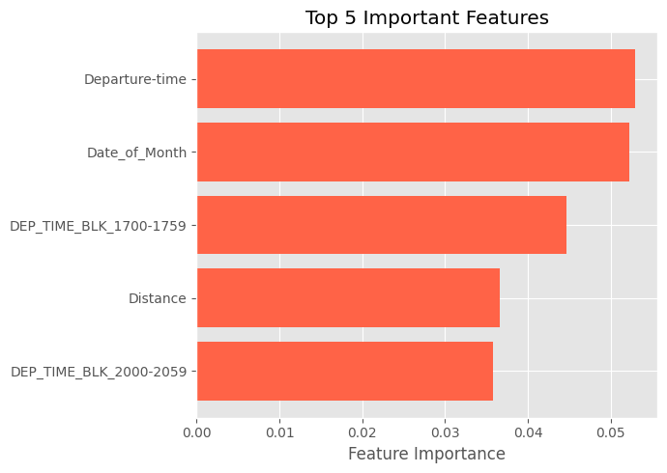
Feature Importance
Departure time and date are top predictors
Evening time blocks (5–6 PM, 8–9 PM) increase delay risk
Distance also impacts delay likelihood

Slide 30

Conclusion:
Departure time and date of month were the most important features
Fligh Delay can be predicted with 81% accuracy
Delay predicted with 79% precision and 74% recall
Soft Voting Ensemble achieved the best balance of precision, recall, and AUC

Slide 31
Thank You!

